Slide 1
Welcome to Marketing Management
Dr. Cecilia Ruvalcaba
BUSI 107 Week 3, Day 1

Slide 2


Lego’s first-ever figurine in a wheelchair
Notes:
Lego’s first-ever figurine in a wheelchair is prompting ‘genuine tears of joy’
https://www.washingtonpost.com/news/morning-mix/wp/2016/01/30/genuine-tears-of-joy-lego-to-release-its-first-ever-figurine-in-a-wheelchair/

Slide 3
Chapter 10: Marketing Research cont…

Slide 4


Different Types of Research
Quantitative
Experimental
Mathematical Modeling
Scanner Data
FMRI
Eye Tracking
Surveys…
Qualitative
Interviews
Observation/ Participant Observation
Focus Groups
Netnography
Videography
Historical research…

Slide 5
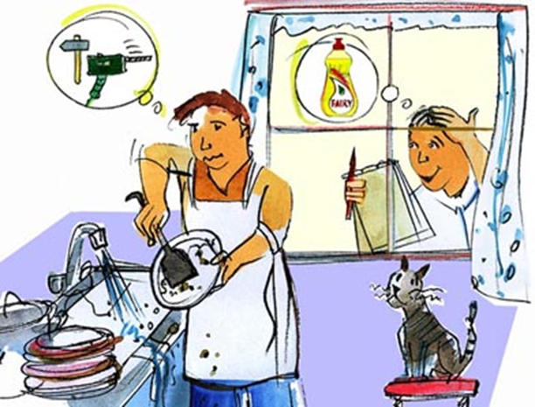
Qualitative Research: Ethnography
A research approach which studies people in their natural settings in order to achieve a cultural interpretation.
Qualitative data analysis helps us make sense of subjectivity by capturing:
(1) meaning,
(2) experience, in the form of specific actions and/or processes, and
(3) relationships, especially those that involve material and/or symbolic inequality.
Study:
Observe customers in real settings.
Talk to customers about their needs and experiences.
Understand what meanings customers attach to or derive from products and services.

Slide 6

Data Collection
You the researcher are the instrument!
Thick Description
Understanding the context
A Wink or a Twitch
How?
Observe
Participate
Listen
Talk
Interpret
Take Notes!!!

Slide 7

Interviews
Sampling Plan
Range (i.e., its dimensions/categories of variation)
Categories of individuals to interview (managers, families, students…)
Redundancy (i.e., recurrences in behavior and speech)
Construct Questionnaire
Open, Non-Directive Questions
Prompts
Intrusive but not obtrusive
Interview Protocol
Before
During
After

Slide 8
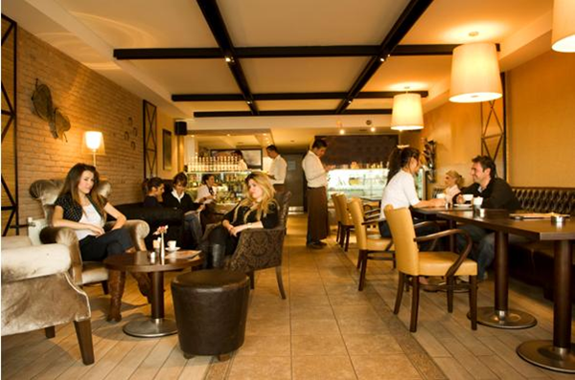
Observation
Sampling
Site
Observation
Behaviors and Non-Behaviors
Facial Gestures
Setting/Environment
People (including staff)
Encounters
Processes/Rituals
Observation Protocol
Before
During
After

Slide 9

Analyzing the Data
Content Coding
What concepts are discussed by each individual.
What are key themes/categories.
Compare across respondents
Look for any shared concepts (1/4, 1/3)
Look for central constructs (main themes/categories)
These are frames of reference
Questions to ask of the data:
What is the overall goal/end state of consuming the product/service
What is not there? Look for any constructs missing that you would expect.
Craft your story

Slide 10
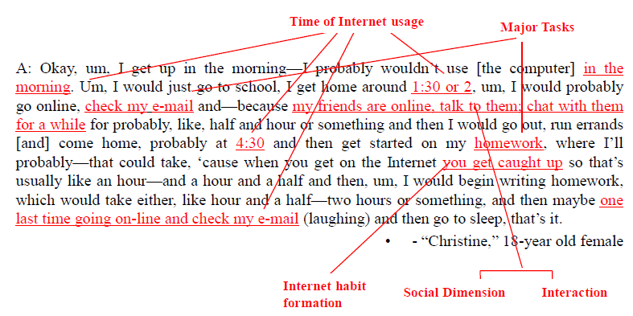
Coding Sample

Slide 11
DATA QUESTIONING OR OPENING THE DATA FOR QUESTIONING
Who? What? When? How much? Why? Where?
Who is the consumer? Respondent? Informant?
Who else is there? What are their positions? Roles? Influences?
What might he/she be thinking when they say something?
What meanings do they attach to things? Where do the meanings come from?
Where is the consumer now?
Where is he/she going to be?
What are his/her plans?
How much does it cost? Weigh? etc.?
What are the experiences?
Why is he/she doing it?
What is the motivation?
What is he/she not doing?
For all of the above, what words in the text trigger this questioning? Context? Words, lines, sentences?

Slide 12

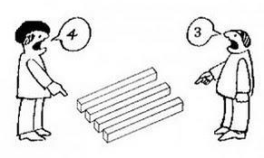

Take Away for Today
Marketing Research: What is the view?
Marketing Data- A Rich Source of Information!
Don’t ignore the opportunities

Slide 13

Next Class
Chapter 10: Marketing Research cont…
Groups
Friday 2/12/16:
Submit Topic & Group Name
Wednesday February 22.
Library Database Session w/ Jack Schroeder

